Slide 1

Introduction to Information Systems ITISA1

Slide 2


Disclaimer
Please note that the content made available on myLMS may deviate slightly from what is covered in lecturer-led sessions. However, the material on myLMS, along with prescribed textbooks and any other designated learning resources, constitutes the compulsory content students are expected to consult and prepare for assessments.

Slide 3


What will be covered in the rest of today’s session?
What will be covered in the lecture-led session:
Business Intelligence (BI) and Analytics
Benefits Achieved from BI and Analytics
Components Required for Effective BI and Analytics

Slide 4
Why Big Data and Analytics?
New data coming from all directions
Nearly a zettabyte per year
1 trillion gigabytes or a 1 followed by 21 zeros
Must analyze large amounts of data
Measure past and current performance
Predict the future
Forecasts drive anticipatory actions
Improve business strategies
Strengthen business operations
Enrich decision making
Organization will become more competitive

Slide 5
Big Data
Big data
Enormous (terabytes or more)
Complex (sensor data to social media data)
Traditional processes incapable of dealing with them

Slide 6
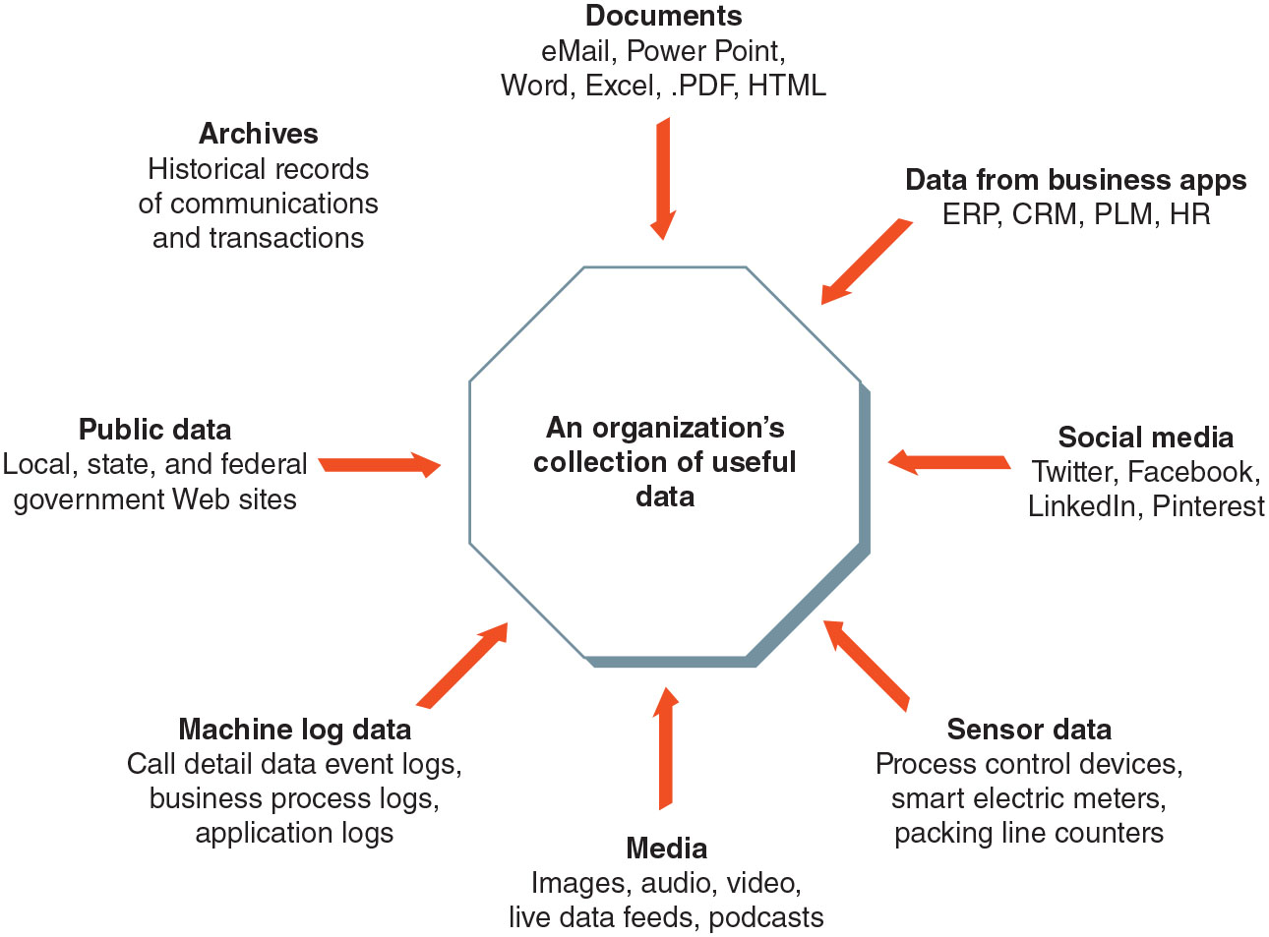
Sources of Big Data

Slide 7

















































Slide 8




















Big Data Uses
Organizations use big data to improve:
Day-to-day operations
Planning
Decision making

Slide 9


































Slide 10
Technologies Used to Manage and Process Big Data
Technologies used to manage and process big data
Data warehouses
Extract Transform Load process
Data marts
Data lakes
NoSQL databases
Hadoop
In-Memory databases

Slide 11
Data Warehouses, Data Marts, and Data Lakes
Online transaction processing (OLTP) systems
Traditionally used to capture data
Do not support data analysis required today
Data warehouses and data marts
Allow organizations to access OLTP data
Support decision making more effectively

Slide 12
Data Warehouse Characteristics
Characteristic | Description
Large | Holds billions of records and petabytes of data
Multiple sources | Data comes from many sources both internal and external thus an extract, transform, load process is required to ensure quality data
Historical | Typically, 5 years of data or more
Cross organizational access and analysis | Data accessed, used, and analyzed by users across the organization to support multiple business processes and decision making
Supports various types of analyses and reporting | Drill down analysis, development of metrics, identification of trends

Slide 13
Data Warehouse
Data warehouse
Large database
Holds business information from many sources in the enterprise
Covers all aspects of the company’s processes, products, and customers
Extract Transform Load (ETL) process
Extracts data from a variety of sources
Edits and transforms data into a data warehouse format
Loads data into the warehouse

Slide 14





























Slide 15
Data Marts, and Data Lakes
Data mart
Subset of a data warehouse
Used by small and medium-sized businesses and departments within large companies
Supports decision making
Data lake
Takes a “store everything” approach to big data
Saves all data in its raw and unaltered form

Slide 16
NoSQL Database
NoSQL database
Differs from a relational database
Data modeled without two-dimensional tabular relations
Uses horizontal scaling
Does not require a predefined schema
Does not conform to true ACID properties when processing transactions
Structures used by NoSQL databases
More flexible than relational database tables
Provide improved access speed and redundancy

Slide 17
Hadoop
Hadoop
Open-source software framework
Includes several software modules
Stores and processes extremely large data sets
Distributed File System (HDFS)
Distributed file system
Used for data storage
Divides the data into subset
Distributes the subsets onto different servers for processing

Slide 18
Analytics and Business Intelligence
Business intelligence (BI)
Wide range of applications, practices, and technologies
Extracts, transforms, integrates, visualizes, analyzes, interprets, and presents data
Supports improved decision making
Analytics
Extensive use of data and quantitative analysis
Supports fact-based decision making within organizations

Slide 19
Benefits Achieved from BI and Analytics
Detect fraud
Improve forecasting
Increase sales
Optimize operations
Reduce costs

Slide 20
The Role of a Data Scientist
Data scientist
Combines several skills
Strong business acumen
Deep understanding of analytics
Healthy appreciation of data, tools, and techniques’ limitations
Delivers real improvements in decision making
Highly inquisitive person
Educational requirements: quite rigorous
Job outlook: extremely bright

Slide 21
Argosy Gaming Company is the owner and operator of six riverboat gambling casinos and hotels in the United States. Argosy has developed a centralized enterprise data warehouse to capture the data generated at each property.
As part of this effort, Argosy selected an extract-transform-load (ETL) tool to gather and integrate the data from six different operational databases to create its data warehouse. The plan is to use the data to help Argosy management make quicker, well-informed decisions based on patrons’ behaviors, purchases, and references.
Argosy hopes to pack more entertainment value into each patron’s visit by better understanding their gambling preferences and favorite services. The data will also be used to develop targeted direct mail campaigns, customize offers for specific customer segments, and adapt programs for individual casinos.
Source: Stair, R. and Reynolds, G. 2018. Principles of Information Systems. 13th edition. UK: Cengage Learning.

Slide 22
Scenario Questions
Critical Thinking Questions
1. The Argosy BI and analytics program is aimed at boosting revenue not at
reducing costs. Why do you think this is so?
2. What specific actions must Argosy take to have a successful program that will
boost revenue and offset some of the increases in costs?
Review Questions
1. What are the key components that Argosy must put into place to create an
environment for a successful BI and analytics program?
2. What complications can arise from gathering data from six different operational
databases covering six riverboat gambling casinos and hotels?

Slide 23
What will be covered in the rest of today’s session?
What will be covered in the lecture-led session:
Data Visualization Tools
Widely used BI software

Slide 24
Effective BI and Analytics

Slide 25
Components Effective BI and Analytics
Three key components
Existence of a solid data management program
Includes governance
Creative data scientists
Strong commitment to data-driven decision making

Slide 26
Business Intelligence and Analytics Tools
Descriptive Analysis | Predictive Analytics | Optimization | Simulation | Text and Video Analysis
Visual analytics | Time series analysis | Genetic algorithm | Scenario analysis | Text analysis
Regression analysis | Data mining | Linear programming | Monte Carlo simulation | Video analysis

Slide 27
Descriptive Analysis
Descriptive analysis
Preliminary data processing stage
Identifies data patterns
Answers questions
Who, what, where, when, and to what extent
Two types
Visual analytics
Regression analysis

Slide 28
Descriptive Analysis
Visual analytics
Presentation of data pictorially or graphically
Word cloud
Visual depiction of a set of words
Words grouped together
Based on frequency of their occurrence
Conversion funnel
Graphical representation
Example: Summary of steps a consumer takes in making the decision to buy a product and become a customer

Slide 29
























Slide 30
Descriptive Analysis
Regression analysis
Determines the relationship between a dependent variable and one or more independent variables
Produces a regression equation
Coefficients represent a relationship
Between each independent variable and the dependent variable
Used to make predictions

Slide 31


























Slide 32
Predictive Analytics
Predictive analytics
Techniques to analyze current data
Identifies future probabilities and trends
Makes predictions about the future
Time series analysis
Uses statistical methods
Analyzes time series data
Extracts meaningful statistics and characteristics

Slide 33








































Slide 34
Predictive Analytics
Data mining
BI analytics tool
Explores large amounts of data for hidden patterns
Predicts future trends and behaviors
Used in decision making
Three common data mining techniques
Association analysis
Neural computing
Case-based reasoning

Slide 35
Optimization
Allocate scarce resources
To minimize costs or maximize profits
Genetic algorithm
Employs a natural selection-like process
Finds approximate solutions to optimization and search problems
Linear programming
Finds the optimum value of a linear expression
Calculated based on the value of a set of decision variables
Variables subject to a set of constraints

Slide 36































Slide 37
Simulation
Emulates the dynamic responses of a real-world system to various inputs
Scenario analysis
Predicts future values based on certain potential events
Monte Carlo simulation
Provides a spectrum of thousands of possible outcomes
Considers the many variables involved
Considers the range of potential values for each variable

Slide 38
Text and Video Analysis
Glean insights and data relevant to decision making
Text analysis
Process for extracting value from large quantities of unstructured text data
Video analysis
Process of obtaining information or insights from video footage

Slide 39
Self-Service Analytics
Self-service analytics
Training, techniques, and processes
Empower end users to work independently
Access data from approved sources
Perform their own analyses
Use an endorsed set of tools
Advantages
Gets valuable data into the hands of end users
Encourages fact-based decision making
Accelerates decision making
Provides a solution to the shortage of data scientists

Slide 40
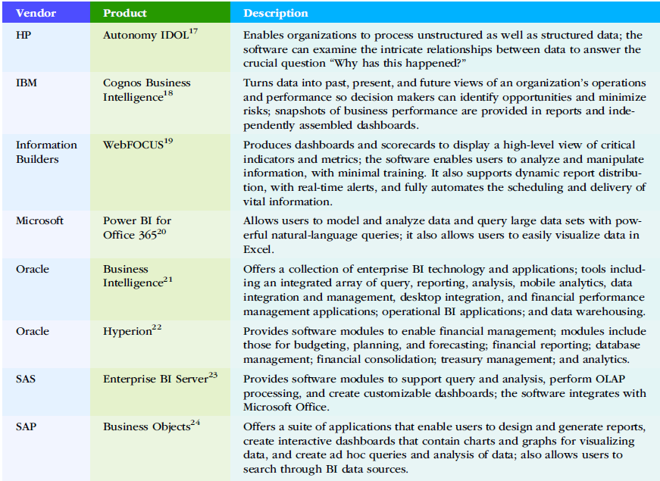
Widely Used BI Software

Slide 41
Activity
What is drill-down analysis and how is it used?
What is data mining? Identify three commonly used data mining techniques.
Provide a definition of business intelligence (BI).
Define self-service analytics? Identify the pros and cons of self-service analytics.

Slide 42
New York City has nearly 1 million buildings, and each year, more than 3,000 of them experience a major fire. The Fire Department of the City of New York (FDNY) is adding BI analytics to its arsenal of firefighting equipment. It has created a database of over 60 different factors (e.g., building location, age of the building, whether it has electrical issues, the number and location of sprinklers) to determine which buildings are more likely to have a fire than others. The values of these parameters for each building are fed into a BI analytics system that assigns each of the city’s 330,000 inspectable buildings a risk score. (FDNY doesn’t inspect single and two-family homes.) Fire inspectors then use these risk scores to prioritize which buildings to visit on their weekly inspections.
Review Questions
1. What kinds of BI analytics tools and techniques is the FDNY likely to use in sifting through all this data and determining a building’s risk score?
2. Identify three other parameters that ought to be taken into consideration when setting priorities for building inspections.
Critical Thinking Questions
1. Can you identify approaches that would be effective in demonstrating the value of BI analytics in reducing the impact of fires in New York City?

Slide 43
What Happens Next?
In the next session we look at Artificial Intelligence and Automation, Chapter 11.

Slide 44
Bibliography
Stair, R. and Reynolds, G. 2020. Principles of Information Systems. 14th edition. Cengage Learning. Chapter 6.

